Slide 1
Roommate Matching: Part 1
Two random people from random cities meeting each other

Slide 2
Two ways of Approaching This
Individuals without Room
Individual with Room
Obtain Facebook login information (Name, Age, Picture, email address)
Obtain Facebook login information (Name, Age, Picture, email address)
Have individual fill out more information (city of interest, price range, male/female, etc.) for their profile page
Have individual fill out more information (Address of place, price of room, male/female, etc.) for their profile page
From the city given, individual will be able to draw on a Google map apartments in the vicinity of interest
From the city given, individual will be able to draw on a Google map apartments in the vicinity of interest
Screen will populate with individuals around that area with similar criteria that are without a room too
Screen will populate with individuals around that area with similar criteria that are without a room too
There will only output a limited amount of people per page
There will only output a limited amount of people per page
Basic information (Interests, price range, occupation) bout them will be displayed with their photo
Basic information (Interests, price range, occupation) bout them will be displayed with their photo
Click like on each person you maybe interested to room with
Click like on each person you maybe interested to room with
If you guys match, you will be notified of a match
If you guys match, you will be notified of a match
Messaging, chatting, and viewing profiles will be allowed
Messaging, chatting, and viewing profiles will be allowed

Slide 3
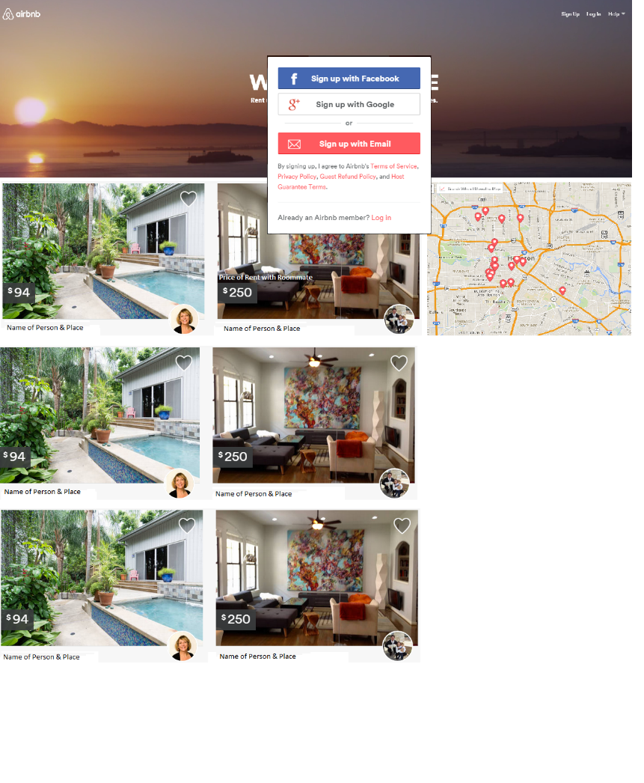
Step 1: Sign in/Log in Page
Signing In
External: Signing in with Facebook/gmail would be the same as logging in with facebook/gmail
Internal: have a separate sign up for users that don’t want to link their facebook/gmail accounts
Logging In
External: Login via authorization access for FB/gmail
Internal: Causes user to type in their log in information
Asks to be remembered in all cases

Slide 4
Extracting Information from FB/Gmail
Information needed
Profile Pic
Name
Age
Sex
Email Address
Current City/From
Friends List

Slide 5
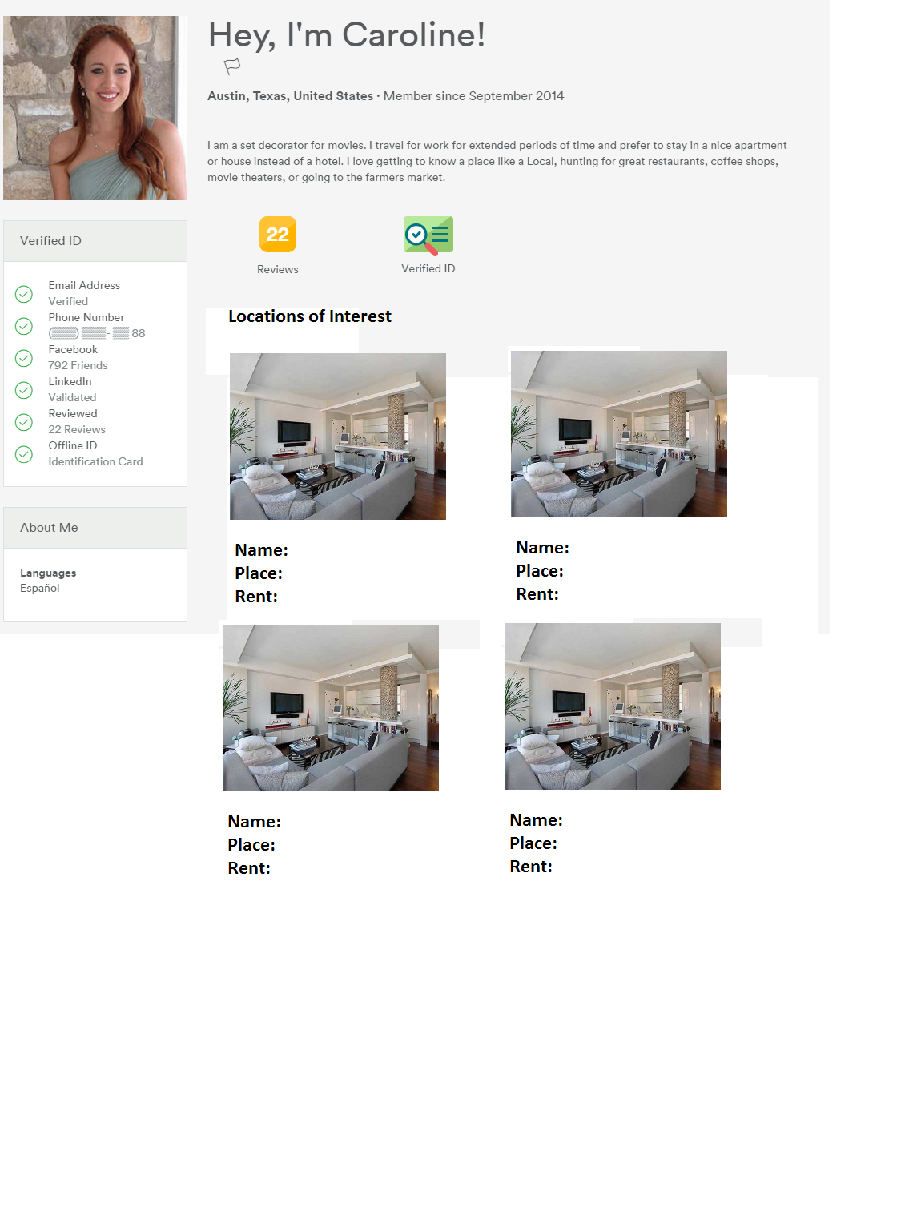
Facebook info -> Profile
The facebook information should automatically feed into your profile
Additionally set up your basic profile for searching for a roommate
4-5 Questions maxed to help us find information on the person
What city are you looking for (Can be drawn or just typed?)
What is your price range
Who are you looking for (male/female)
Occupation (Student/Job)
Move in Date
Questions can be placed here

Slide 6
Finding possible Matches (5 Questions & FB)
Login with
Collect Info
Users DB
Filter Profiles
Find whether those mutual friends have accounts within database
Access Friends of the Friends list (People you may know tab)
Questions/Facebook
Users Friends List
Facebook
Filter based Collected info
Display results
You
Use all users database
Server Side
Questions

Slide 7
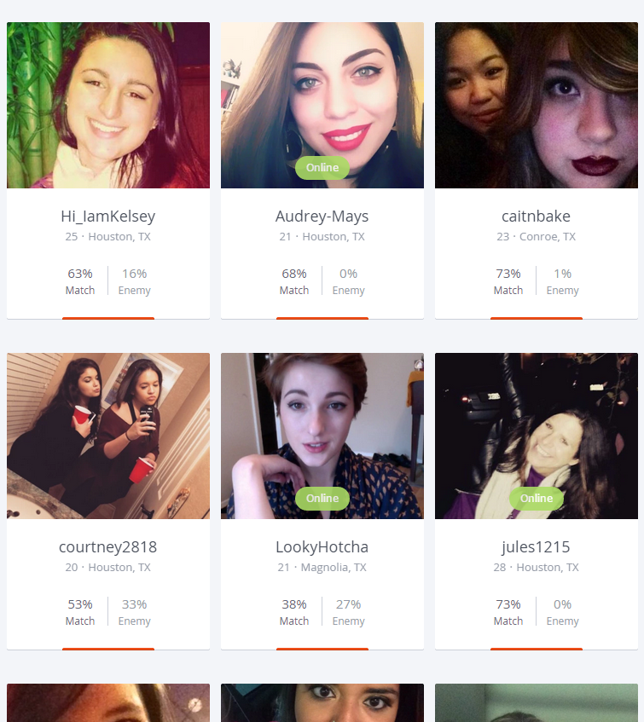
Listing of Mutual Friends
Similar to OKCupid in display and functionality

Slide 8
Matching
Similar to OKCupid/Tinder – A single like button will be used
A separate DB will be needed to store which individuals you like based on ID
If there are identical ID matches a notification will be sent to both of them
If they are matched, they profile/chatting between them will be allowed
Individual 1
Individual 2
1
2
2
1

Slide 9
Un-Matching
Allow Users to Unmatch placed on the matched person’s profile
Create another DB for users that unmatch
If the DB for unmatch = DB of matched then do not allow permission between the users
Individual 1
Individual 2
Individual 1
Individual 2
1
2
1
7
2
1
3
1
1
10
1
2
5
2
1
6

Slide 10
Future add in
Work with properties or extract information from various 3rd party websites to obtain potential apartment/condos for individuals to room in

